Slide 1
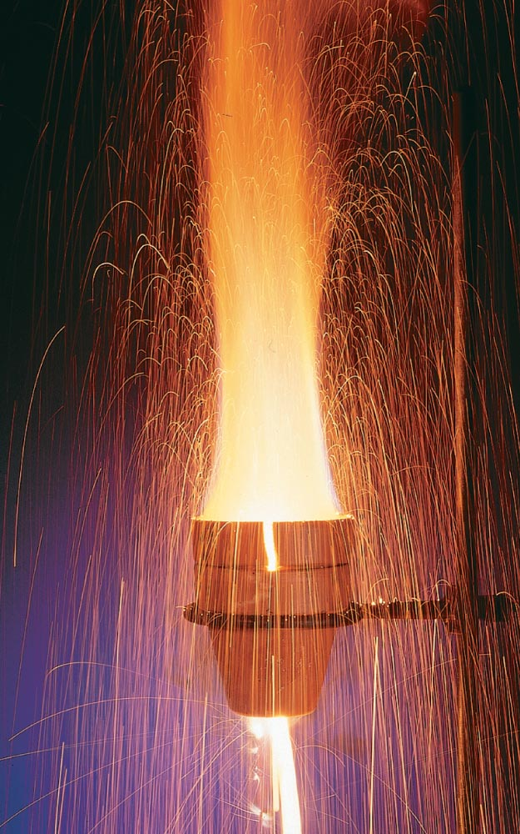
Zumdahl Chapter 6
THERMOCHEMISTRY
HEATS OF REACTION AND CHEMICAL CHANGE

Slide 2
6.1 Energy
Energy – the capacity to do work or produce heat.
Law of Conservation of Energy(1st law of thermodynamics)– energy is neither created nor destroyed. (energy of universe is constant)
Potential Energy – energy stored due to position or composition.
Kinetic Energy – energy due to motion of an object. ½ mv²
Energy is a State Function (or Property) – a system property depending only on its present state.
Notes:
Another name for the Law of Conservation of Energy is The First Law of Thermodynamics, the energy of the universe is constant.
What is the PE of A in the final cartoon? Who knows? It could be saddle function, both a minima and maxima. Energy is best measured as a difference between two states. You could roll a ball down the Hillary Step and it might land in the groove of the Step. It would still be 8000 m high.
For everyone in this room, the state function of location is Los Angeles. It doesn’t matter if you were born in SGM 123 and you’ve never left or you were born in another country, traveled all around the world, climbed mount everest, took a submarine ride down the the bottom of the ocean and then traveled to USC. What matters is that here you are. The state function of temperature of most of you is 37.0 C, but it doesn’t matter if you’ve had a fever before or you lived in Antarctica.

Slide 3
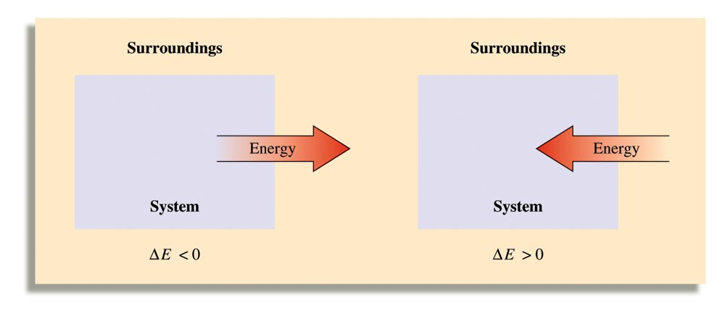
6.1 System vs Surroundings
System – a defined environment
Surroundings – everything else
Your text is written from the system’s perspective (e.g., “energy is lost” = “the system loses energy”).

Slide 4
6.1 Components of Energy
Heat (q) – transfer of energy due to a temperature difference.
+q, ΔE_{sys} increases
-q, ΔE_{sys} decreases
Work (w) – force acting over a distance.
+w, ΔE_{sys} increases
-w, ΔE_{sys} decreases
Unlike energy, heat and work are not state functions.
ΔE_{sys} = -ΔE_{surroundings}
-ΔE_{sys} = ΔE_{surroundings}
ΔE_{sys} = -ΔE_{surround}
−ΔE_{sys} = ΔE_{surround}
ΔE = q + w

Slide 5
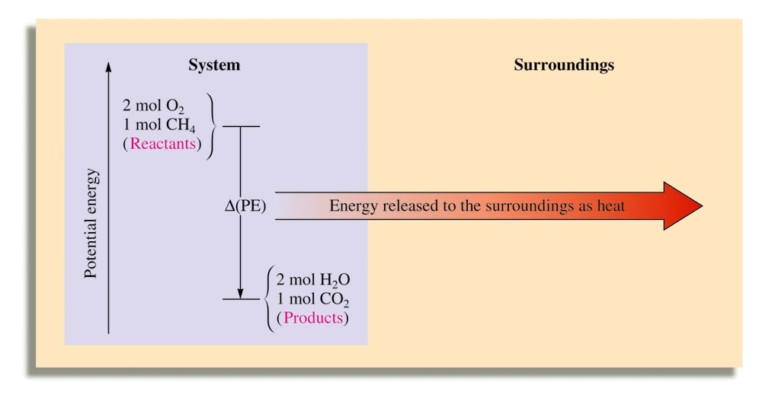
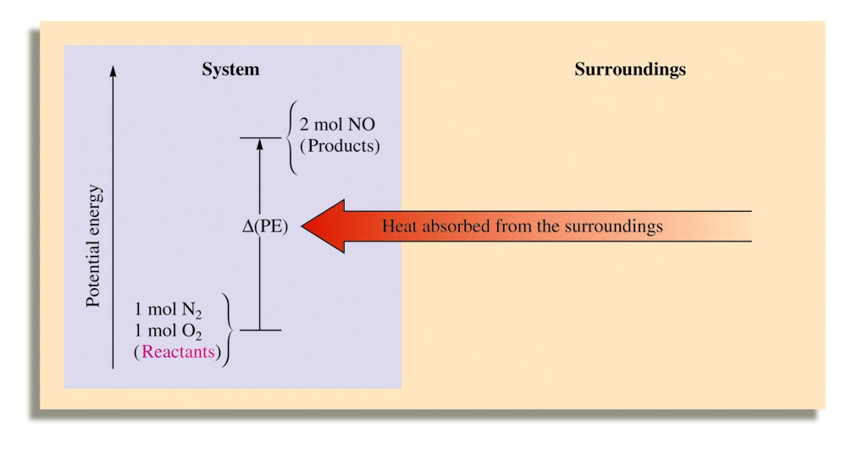
6.1 Exothermic vs Endothermic Reactions
Exothermic reactions release energy.
Endothermic reactions absorb energy.
−ΔE_{sys} = ΔE_{surround}
PE (bonds) ⎯→ KE (heat)
New bonds are stronger
ΔE_{sys} = -ΔE_{surround}
KE (heat) ⎯→ PE (bonds)
New bonds are weaker

Slide 6
6.1 Fluid Work (p. 233-4)
Gases do work via volume change according to the formula below. The system is often a gas-filled piston.
When a gas expands (+ΔV), work is negative.
When a gas compresses (-ΔV), work is positive.
Units of gas expansion/compression work are conveniently L · atm. 1 L · atm = 101.3 J.
w = -PΔV

Slide 7
6.1 Fluid Work (p. 233-4)
One mol H₂O_{(g)} at 1.00 atm and 100. °C has a volume of 30.6 L. When condensed to 1 mol H₂O_{(l)}, 40.66 kJ of heat is released. Calculate ΔE for the condensation of 1 mol of H₂O_{(g)} at 1.00 atm and 100. °C; the density of H₂O_{(l)} under these conditions is 0.996 g/mL.
ΔE = q + w
ΔE = q - PΔV
w = -PΔV
1 mol H₂O_{(l)}
18.02 g H₂O_{(l)}
1 mol H₂O_{(l)}
1 mL H₂O_{(l)}
0.996 g H₂O_{(l)}
= 18.1 mL H₂O_{(l)}
-PΔV = -(1.00 atm)(0.0181 L – 30.6 L)
1 kJ
10³ J
= 3.10 kJ
101.3 J
L · atm
ΔE = q - PΔV = -40.66 kJ + 3.10 kJ = -37.56 kJ

Slide 8
What work is done when a gas is compressed from 45 L to 20 L at a constant external pressure of 5 atm?
w = -PΔV
w = -(5 atm)(-25 L)
w = + 125 L · atm

Slide 9
6.2 Enthalpy
Enthalpy (H) is the heat evolved in a chemical reaction at constant pressure. It is defined as:
E = system energy
P = system pressure
V = system volume
H = E + PV
Since E, P and V are all state functions, so is H.
ΔH represents only heat exchanged; ΔE represents heat and work exchanged. For many reactions, the values of ΔH and ΔE are similar in magnitude.

Slide 10
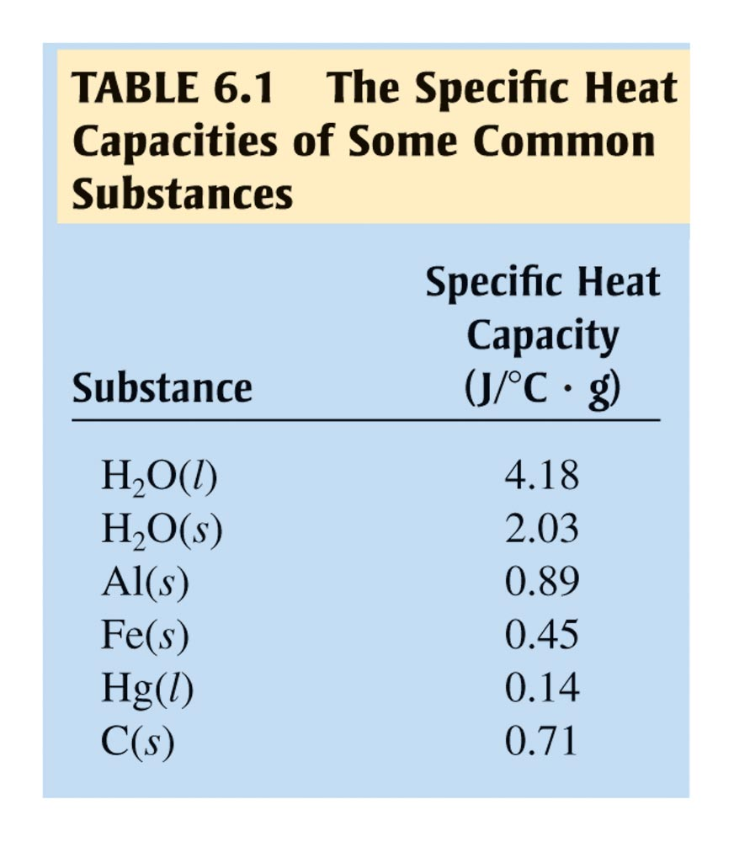
6.2 Calorimetry
Calorimetry is the science of measuring heat.
Specific heat capacity – the energy required to raise 1 g of a substance by 1 °C (or 1 K).
Molar heat capacity – the energy required to raise 1 mol of a substance by 1 °C (or 1 K).

Slide 11
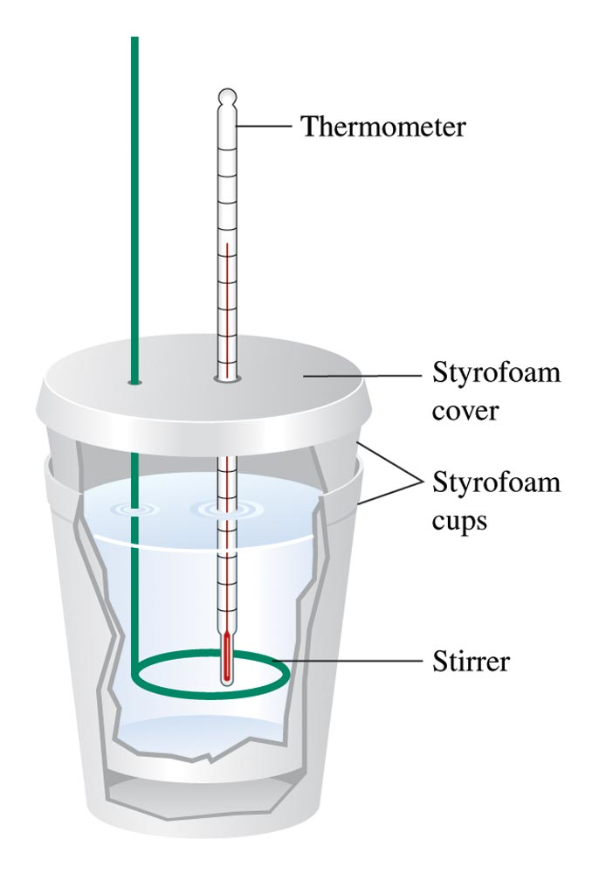
6.2 Constant Pressure Calorimetry
Constant-pressure calorimeters are run at atmospheric pressure and are used to determine ΔH for reactions in solution.
Any observed temperature increase is due to release of energy, calculated by:
c = specific heat capacity
m = mass of solution
ΔT = change in temperature
ΔH = c · m · ΔT

Slide 12
6.2 Constant Pressure Calorimetry
When burned in air, H₂ releases 120. J/g of energy and methane gives off 50. J/g. If a mixture of 5.0 g of H₂ and 10. g CH₄ are burned and the heat released is transferred to 50.0 g water at 25.0 °C, what will be the final temperature of the water?
For H₂O_{(l)} , c = 4.18 J/°C · g
ΔH = c · m · ΔT
ΔH = (120. J/g H₂)(5.0 g H₂) + (50. J/g CH₄)(10. g CH₄)
ΔH = 1100 J
1100 J = s · m · ΔT
1100 J = (4.18 J/°C · g H₂O) · (50.0 g H₂O) · ΔT
ΔH = s · m · ΔT
ΔT = 5.26°C
Final temp = 25.0 °C + 5.26°C = 30.3°C

Slide 13
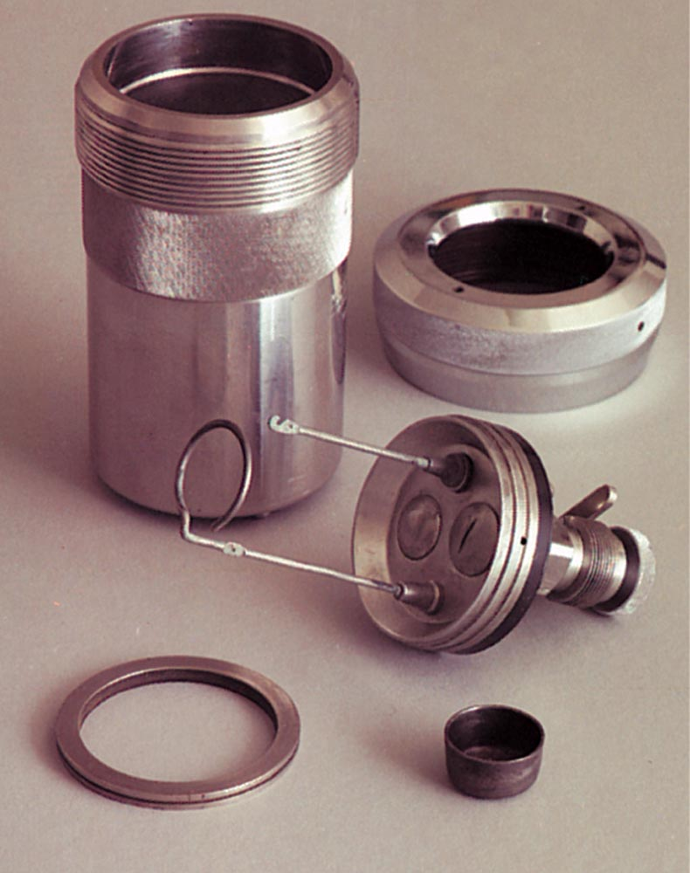
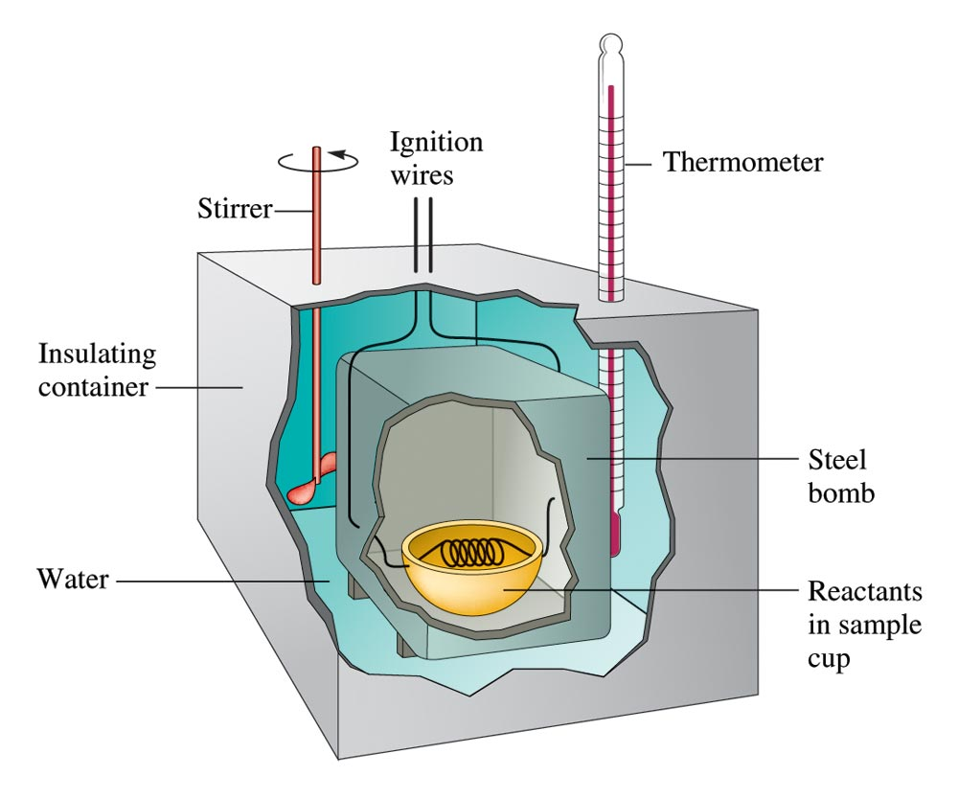
6.2 Constant Volume Calorimetry
Constant-volume calorimeters are called bomb calorimeters. The reaction occurs in an internal steel chamber.
Since the volume of the chamber is constant, no work is done. All the energy, therefore, is released as heat.
ΔE = q_{V} = C_{cal} · ΔT
C_{cal} = heat capacity of
calorimeter
ΔT = temperature
change
ΔE = q + w
ΔE = q_{V}
q_{V} = heat at constant volume

Slide 14
6.2 Constant Volume Calorimetry
Silver(II) fluoride is an extremely rare example of silver in the +2 oxidation state. Using a bomb calorimeter with a heat capacity of 10.9 kJ/°C, decomposition of 249.4 g AgF₂ reacts violently in the presence of xenon gas. If the temperature of the bomb increased from 22.12 to 29.62 °C, calculate the energy released per mole of AgF₂.
AgF_{2(s)} + Xe_{(g)} ⎯→ Ag_{(s)} + XeF_{2(s)}
q_{rxn} = ΔT · (heat capacity of calorimeter)
= 47.8 kJ/mol AgF₂
q_{rxn} = (29.62 – 22.12 °C) · (10.9 kJ/°C)
q_{rxn} = (7.50 °C) · (10.9 kJ/°C) = 81.8 kJ
81.8 kJ
249.4 g AgF₂
1 mol AgF₂
145.865 g AgF₂
= 1.71 mol AgF₂
1.71 mol AgF₂
= -47.8 kJ/mol AgF₂

Slide 15
6.2 Enthalpy
At constant pressure, a system’s enthalpy change equals the energy flow as heat:
For a reaction at constant pressure, ΔH is given by:
If ΔH is positive, the reaction is endothermic.
If ΔH is negative, the reaction is exothermic.
ΔH = q_{P}
ΔH_{reaction} = H_{products} - H_{reactants}

Slide 16
6.3 Calculating ΔH_{reaction}
There are three quantitative relationships between a chemical equation and ΔH:
1) If a chemical equation is multiplied by some integer, ΔH is also multiplied by the same integer.
3A + B ⎯→ 2C ΔH
2 · (3A + B ⎯→ 2C) 2 · (ΔH)
6A + 2B ⎯→ 4C 2ΔH
2) If a chemical equation is reversed, then ΔH changes sign.
A + B ⎯→ C + D ΔH
C + D ⎯→ A + B -ΔH
Notes:
These relationships allow us to calculate delta H for a reaction without directly measuring it in the lab.

Slide 17
6.3 Calculating ΔH_{reaction}
Hess’ Law
3) If a chemical reaction can be expressed as the sum of a series of steps, then ΔH for the overall equation is the sum of the ΔH’s for each step.
3A + B ⎯→ C ΔH₁
C ⎯→ 2D ΔH₂
3A + B ⎯→ 2D ΔH₁ + ΔH₂
Since enthalpy is a state function, ΔH is dependent only on initial and final states.

Slide 18
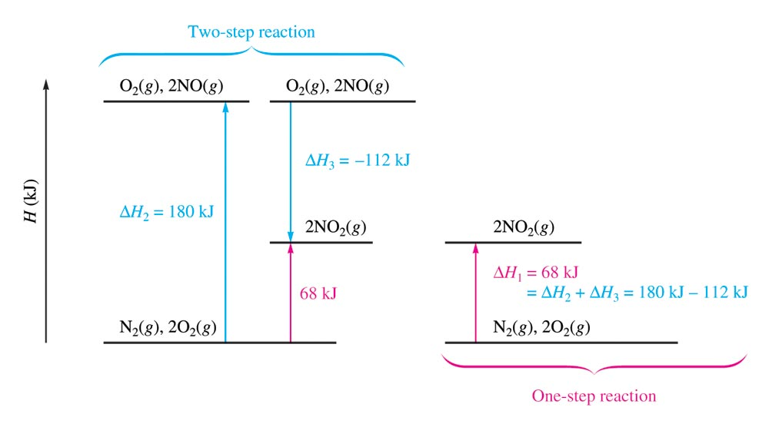
6.3 Hess’ Law

Slide 19
6.3 Calculating ΔH_{reaction}
Find ΔH for the formation of propane using the reactions and corresponding ΔH values below.
3C_{(s)} + 4H_{2(g)} ⎯→ C₃H_{8(g)}
C₃H_{8(s)} + 5O_{2(g)} ⎯→ 3CO_{2(g)} + 4H₂O_{(g)} ΔH = -2043 kJ
3CO_{2(g)} + 4H₂O_{(g)} ⎯→ C₃H_{8(s)} + 5O_{2(g)} ΔH = +2043 kJ
C_{(s)} + O_{2(g)} ⎯→ CO_{2(g)} ΔH = -393.5 kJ
3 · [C_{(s)} + O_{2(g)} ⎯→ CO_{2(g)}] 3 · ΔH = -393.5 kJ
3C_{(s)} + 3O_{2(g)} ⎯→ 3CO_{2(g)} ΔH = -1180.5 kJ
2 ·[O_{2(s)} + 2H_{2(g)} ⎯→ 2H₂O_{(g)}] 2 · ΔH = -483.6 kJ
2O_{2(s)} + 4H_{2(g)} ⎯→ 4H₂O_{(g)} ΔH = -967.2 kJ
O_{2(s)} + 2H_{2(g)} ⎯→ 2H₂O_{(g)} ΔH = -483.6 kJ
3C_{(s)} + 4H_{2(g)} ⎯→ C₃H_{8(g)} ΔH = -105 kJ

Slide 20
6.4 Standard States
Standard states - arbitrary sets of conditions for calculating thermodynamic state properties (ΔH, ΔE, ΔG).
For compounds:
Gases - 1 atm of pressure
Solutions - exactly 1 M
Liquids and solids – pure, 1 atm
For elements:
1 atm and 25 ºC
Don’t confuse standard state with STP of gases.

Slide 21
6.4 Standard Enthapy of Formation
Standard Enthalpy of Formation ( ) – the ΔH when 1 mol of a compound forms from its elements in their standard states.
For a pure element in its standard state, = 0.
The degree symbol (°) indicates standard states.
Standard Enthalpy of Formation ( ) – the ΔH when 1 mol of a compound forms from its elements in their standard states.
For a pure element in its standard state, = 0.
The degree symbol (°) indicates standard states.

Slide 22
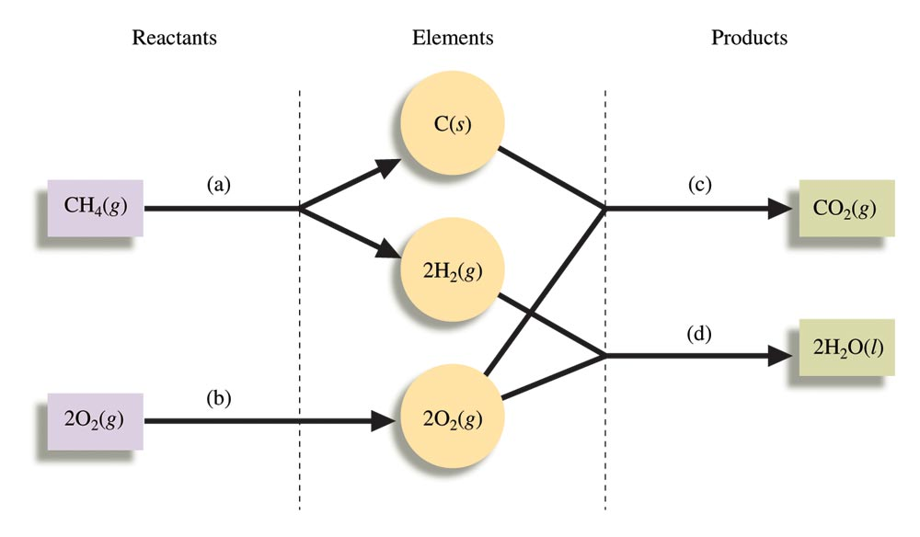
6.4 Standard Enthapy of Formation

Slide 23
6.4 Standard Enthapy of Formation
Write equations for the formation of MgCO_{3(s)} and C₆H₁₂O_{6(s)} from their elements in their standard states.
Mg_{(s)} + C_{(s, graphite)} + O_{2(g)} ⎯→ MgCO_{3(s)}
Mg_{(s)} + C_{(s, graphite)} + O_{2(g)} ⎯→ MgCO_{3(s)}
Mg_{(s)} + C_{(s, graphite)} + O_{2(g)} ⎯→ MgCO_{3(s)}
Mg_{(s)} + C_{(s, graphite)} + O_{2(g)} ⎯→ MgCO_{3(s)}
6C_{(s, graphite)} + 6H_{2(g)} + 3O_{2(g)} → C₆H₁₂O_{6(s)}
6C_{(s, graphite)} + 6H_{2(g)} + 3O_{2(g)} → C₆H₁₂O_{6(s)}
6C_{(s, graphite)} + 6H_{2(g)} + 3O_{2(g)} → C₆H₁₂O_{6(s)}
6C_{(s, graphite)} + 6H_{2(g)} + 3O_{2(g)} → C₆H₁₂O_{6(s)}
C_{(s, graphite)} = 0 kJ/mol; C_{(s, diamond)} = 2 kJ/mol

Slide 24
6.4 Standard Enthapy of Reaction, 1111111
The enthalpy change for a given reaction is calculated by subtracting the enthalpies of formation of the reactants from the enthalpies of formation of the products:
Elements in their standard states aren’t included since their is zero.
= Σ n_{p} [products] - Σ n_{r} [reactants]

Slide 25
6.4 Standard Enthapy of Reaction, 1112111
Calculate for the combustion of octane (C₈H₁₈).
C₈H_{18(l)} + O_{2(g)} ⎯→ CO_{2(g)} + H₂O_{(g)}
C₈H_{18(l)} + O_{2(g)} ⎯→ 8CO_{2(g)} + 9H₂O_{(g)}
Substance (kJ/mol)
C₈H_{18(l)} -250.1
O_{2(g)} 0
CO_{2(g)} -393.5
H₂O_{(g)} -242
This data was obtained from Appendix 4, p. A21.
= Σ n_{p} [products] - Σ n_{r} [reactants]
= [8(-393.5 kJ) + 9(-242 kJ)] – [-250.1 kJ + 0 kJ]
= -5324.2 kJ – (-250.1 kJ) = -5075 kJ/mol
Notes:
NOTE: This answer is slightly different from the one in your text on pg. 252, even though both problems solve for the ΔHrxn of combustion of octane. Two differences:
I (this problem) solves for gaseous water. Your text solves for liquid water.
This problems solves kJ/mol. The problem is your text is off by roughly a factor of two since it solves for 2 mols of octane.
Should you worry? No, on the exam this type of ambiguity will not appear. You will be told exactly what units your answer should be in and what states of matter all reactants and products will be in.

