Slide 1
Periodic Trends and Bonding

Slide 2
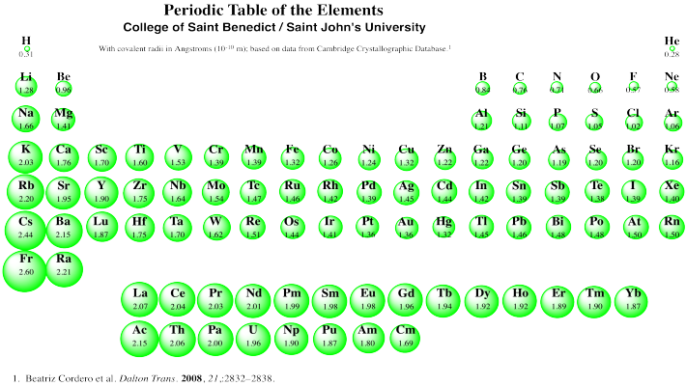
Atomic Radius
Half the distance between the nuclei in a molecule of two identical atoms
Decreases going across the periodic table because of an increase in effective nuclear charge
Increases going down the periodic table because increased orbital size

Slide 3
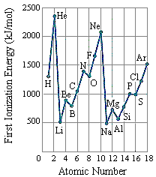
Ionization Energy
The energy required to remove an electron from an atom or ion
Generally:
Increases going across because increase in effective nuclear charge holds the atom/ions electrons more tightly to the nucleus
Decreases going down because the increased number of energy level shields the valence electrons from the nuclear charge, not forcing the electrons to stay as attracted to the nucleus

Slide 4
Ionization Energy Cont.
Exceptions to the rule :)
Be → B
1s²2s² vs 1s²2s²2p¹
The filled 2s sublevel some shielding for the 2p electrons
N → O
1s²2s²2p³ vs 1s²2s²2p⁴
* The second electron going into the first 2p orbital creates some electron-electron repulsion

Slide 5
Electron Affinity
The energy change associated with the addition of an electron to an atom
* When an electron is added, if favorable, the atom will lose energy, going to a lower energy state which is favorable. Losing energy is an exothermic heat exchange, meaning that the value of energy would be negative.

Slide 6
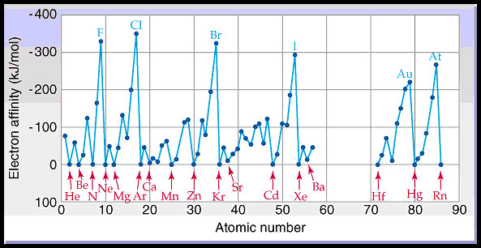
Electron Affinity Cont.
General Trend
Becomes more negative going across the periodic table because there is a greater nuclear charge attracting electron, making the addition of that electron more favorable
Becomes more positive going down the periodic table because the greater number of orbital shielding the nucleus decrease the extreme change in stability with the addition of an electron

Slide 7
Electron Affinity Cont.
Carbon vs Nitrogen
Carbon would be more negative because adding another electron would not cause any repulsions in a single orbital, where in nitrogen case you are doubling up an orbital that previously had only one electron in it
Fluorine vs Chlorine
Chlorine would have a more negative electron affinity because fluorine is very small creating too many electron repulsions.
Exceptions to the rule ☺

Slide 8
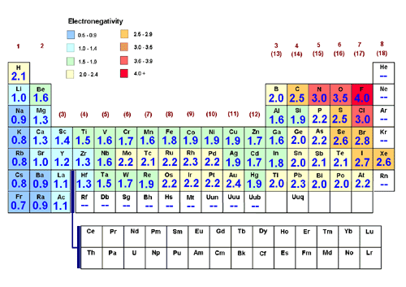
Electronegativity
General Trends
Increases going across the periodic table because the effective nuclear charge increases, allowing the protons to attract additional electrons easier
Decreases going down the periodic table because larger orbital shield the protons positive pull, not allowing it to pull electrons as easily.
- The ability to attract and electron

Slide 9
Electronegativity Cont.
Noble Gases!
They already have a full orbital. They do not want to attract anymore electrons to create a partially filled sublevel.
Exceptions to the rule ☺

Slide 10
Reactivity
Metals
Reactivity increases going down a group and decreasing going across the periodic table
Most reactive metals are on the bottom-left of periodic table (alkali metals)
Non-metals
Reactivity decreases going down a group and increases going across the periodic table (except noble gases)
Most reactive nonmetals are on the top-right of the periodic table (halogens)

Slide 11
Types of Bonding and EVERYTHING that goes with it

Slide 12
Types of Bonds based on Electronegativity
The greater the difference in electronegativity between two atoms that are bonding together, the more polar the bond, meaning that one atom pulls the electrons in the bond closer to it instead of the electrons being shared right between the two atoms.
Difference in electronegativities (Δ_{x})
Ionic Δ_{x} > 1.7
Polar Covalent 1.7 ≥ Δ_{x} ≥ 0.5
Covalent Δ_{x} < 0.5

Slide 13
Types of Bonds
Ionic
Covalent
Metallic
Know general properties of the three types of compounds and be able to explain these properties based on structure
Example: boiling point, conductivity, malleability…..

Slide 14
Lewis Structures
This is a way for us to represent how molecules form through the sharing of electrons in covalent bonds.
Steps:
Count number of valence electrons
Attach each atom using a single bond
Make sure that each atom has 8 electrons around it by adding lone pairs when necessary (H and He can only have 2, B can only have 6)

Slide 15
Lewis Structures Cont.
Add up number of electrons in structure
If more than valence electrons “take away a pair, take away a pair, make them share”
If not enough, add lone pairs to CENTRAL atom only

Slide 16
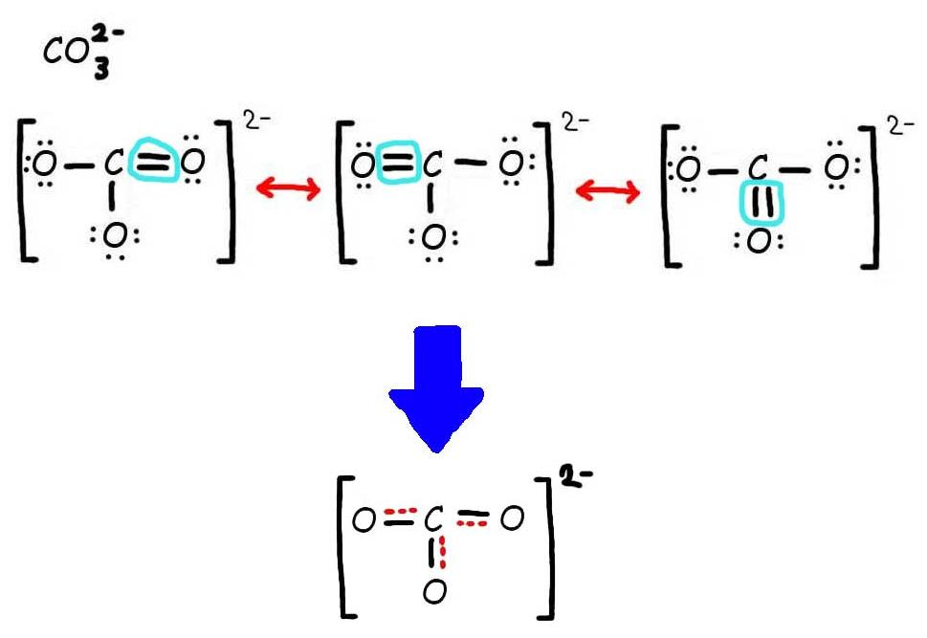
Lewis Structures cont.
Resonance Structures – occurs when there is more than one acceptable lewis structure for the same molecule. The actual structure of the molecule is an average of all the resonance structures.

Slide 17
Lewis Structures – Formal Charge
Sometimes multiple lewis structures for the same molecule seem to work and we need to figure out which one is most likely the one the molecule is most like. We do this through calculating formal charge.
Formal charge: the difference between the number of valance electrons that element has verse the number of valence electrons that an atom has in the molecule
FC = (# of VE on free atom) – (# of VE assigned to atom in the molecule)

Slide 18
Lewis Structure – Formal Charge
Rules:
The sum of the formal charges must equal the charge on the molecule.
All atoms want to have a formal charge as close to zero as possible
If an atom has a negative formal charge, it must be the most electronegative atom in the molecule.

Slide 19
VSEPR Theory
Valence Shell Electron Pair Repulsion
Electrons arrange themselves to be as far as possible from other electrons
*need to memorize the shape, bond angle*

Slide 20
Hybridization
The mixing of atomic orbitals for bonding
Hybridizations When to use them
s 1 domain (steric number)
Sp 2 domains
Sp² 3 domains
Sp³ 4 domains
Sp³d 5 domains
Sp³d² 6 domains

Slide 21
Bond Energies
We can calculate the change in energy throughout the course of the reaction by calculating the amount of energy required to break the reactants apart and the amount of energy released when the bonds in the products are formed.
Breaking bonds required energy (+ kj/mol)
Making bonds releases energy ( - kj/mol)

Slide 22
Bond Energies Cont.
*Have to break them to make them*
*bond energies will be given to you*

