Slide 1
ZUMDAHL’S CHAPTER 16
Spontaneity, Entropy, Free Energy, and
Why All Things Happen …
“The Universe Becomes Less Predictable”

Slide 2
SPONTANEOUS PROCESSES AND ENTROPY
One of the main objectives in studying thermodynamics, as far as chemists are concerned, is to be able to predict whether or not a reaction will occur when reactants are brought together under a special set of conditions (for example, at a certain temperature, pressure, and concentration).
‹#›
Notes:
‹#›

Slide 3
2ND LAW OF THERMODYNAMICS
“In any spontaneous process, the entropy of the Universe increases.”
We must include consideration of a system’s environment to apply this law.
For example, condensing a gas implies a large decrease in the system’s entropy! ΔS_{sys} << 0
Fortunately, the (latent) heat of vaporization gets released to force the surroundings to occupy higher energy levels, so ΔS_{surr} >> 0 and ΔS_{univ} > 0!
ΔS_{univ} = ΔS_{sys} + ΔS_{surr} ≥ 0

Slide 4
UNIVERSAL CHAOS, S_{UNIV}
There is Chaos growing in the Universe all the time at the expense of Order. It is now a fundamental principle of Science.
It’s called “entropy,” S, and is a state function that must always increase for the Universe as a whole, but some System’s S may decrease.

Slide 5
Entropy (S) is a measure of the randomness or disorder of a system.
order
S
disorder
S
ΔS = S_{f} - S_{i}
If the change from initial to final results in an increase in randomness
S_{f} > S_{i}
ΔS > 0
+ΔS; favors a spontaneous reaction for a chemical reaction
−ΔS; favors a non-spontaneous reaction for a chemical reaction or does not happen
18.2
Notes:
‹#›

Slide 6
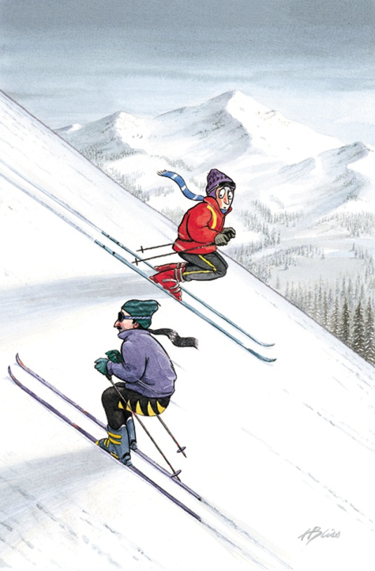
Spontaneous Physical and Chemical Processes
A waterfall runs downhill
A lump of sugar dissolves in a cup of coffee
At 1 atm, water freezes below 0 ⁰C and ice melts above 0 ⁰C
Heat flows from a hotter object to a colder object
A gas expands in an evacuated bulb
Iron exposed to oxygen and water forms rust
spontaneous
nonspontaneous
18.2

Slide 7
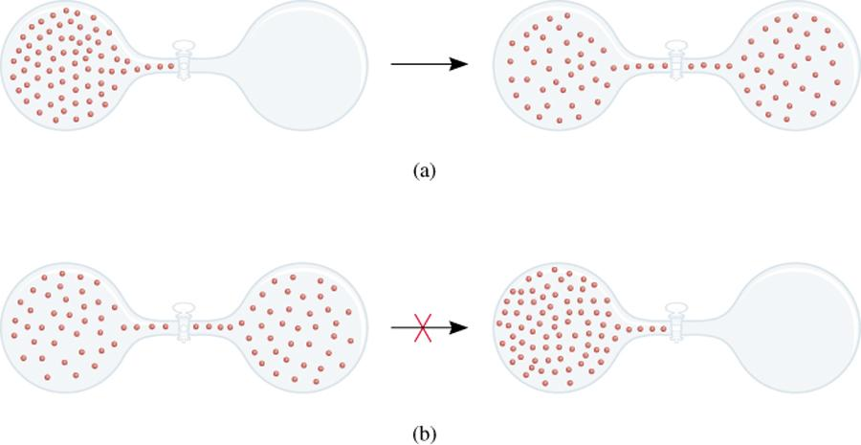
spontaneous
nonspontaneous
18.2

Slide 8
Enthalpy is a factor in whether a reaction is spontaneous; but is not the only factor.
Spontaneous reactions
CH₄ (g) + 2O₂ (g) CO₂ (g) + 2H₂O (l) ΔH⁰ = -890.4 kJ
H⁺ (aq) + OH⁻ (aq) H₂O (l) ΔH⁰ = -56.2 kJ
H₂O (s) H₂O (l) ΔH⁰ = 6.01 kJ
H₂O
NH₄NO₃ (s) NH₄⁺(aq) + NO₃⁻ (aq) ΔH⁰ = 25 kJ
18.2

Slide 9
AN EXOTHERMIC REACTION (-ΔH) FAVORS A SPONTANEOUS REACTION SINCE PRODUCTS ARE AT A LOWER POTENTIAL ENERGY BUT DOES NOT GUARANTEE IT.
Reactants
-ΔH
Potential Energy
Products

Slide 10
Guidelines for Determining if ΔS is + or -.
1. For any substance, the solid state is more ordered than the liquid state and the liquid state is more ordered than gas state
S_{solid} < S_{liquid} << S_{gas}
H₂O (s) H₂O (l)
ΔS > 0
Notes:
‹#›

Slide 11
Guidelines for Determining if ΔS is + or -.
Entropy often increases when one material dissolves in another.
Entropy increases as Temperature increases.
Notes:
‹#›

Slide 12
Guidelines for Determining if ΔS is + or -.
4. When gases are produced (or consumed)
If a reaction produces more gas molecules than it consumes, ΔS⁰ > 0.
If the total number of gas molecules diminishes, ΔS⁰ < 0.
If there is no net change in the total number of gas molecules, then ΔS⁰ may be positive or negative BUT ΔS⁰ will be a small number.
What is the sign of the entropy change for the following reaction?
2Zn (s) + O₂ (g) 2ZnO (s)
The total number of gas molecules goes down, ΔS is negative.
18.3
Notes:
‹#›

Slide 13
Guidelines for Determining if ΔS is + or -.
5. Entropy increases as number of moles of gases increases during chemical reaction.
N₂ (g) + 3 H₂ (g) -> 2 NH₃ (g)
4 moles gas
2 moles gas
- ΔS
6. Entropy increases as the complexity of the molecule increases.
C₄H₁₀
or
CH₄
Higher entropy
Notes:
‹#›

Slide 14
How does the entropy of a system change for each of the following processes?
(a) Condensing water vapor
Randomness decreases
Entropy decreases (ΔS < 0)
(b) Forming sucrose crystals from a supersaturated solution
Randomness decreases
Entropy decreases (ΔS < 0)
(c) Heating hydrogen gas from 60⁰C to 80⁰C
Randomness increases
Entropy increases (ΔS > 0)
(d) Subliming dry ice
Randomness increases
Entropy increases (ΔS > 0)
18.2

Slide 15
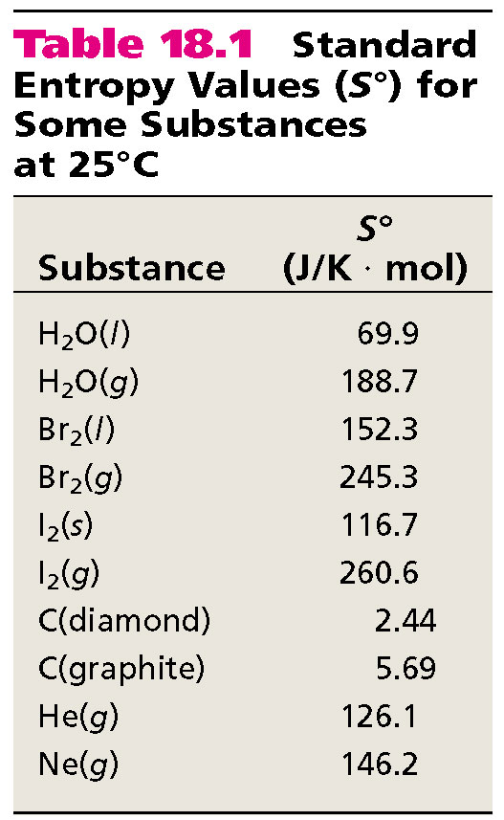
Notes:
‹#›

Slide 16
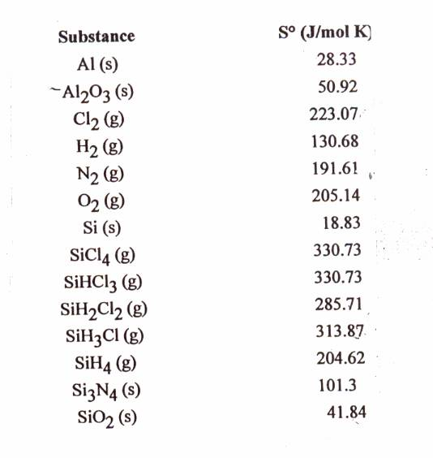
STANDARD ENTROPY VALUES; S°
240
Notes:
‹#›

Slide 17
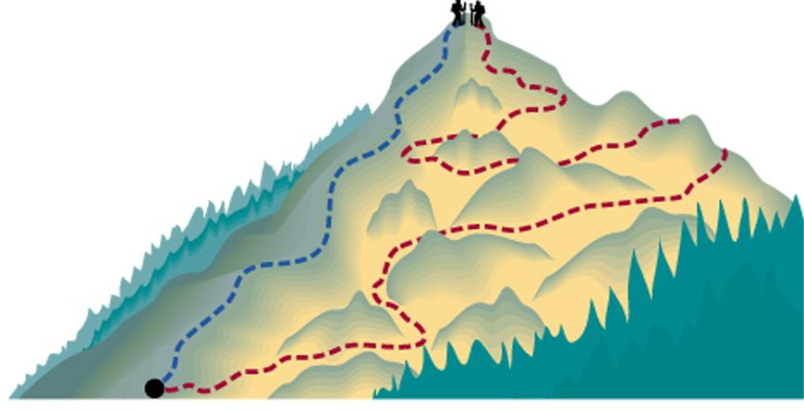
Thermodynamics
State functions are properties that are determined by the state of the system, regardless of how that condition was achieved.
energy, enthalpy, pressure, volume, temperature
, entropy
Potential energy of hiker 1 and hiker 2 is the same even though they took different paths.
6.7
Notes:
‹#›

Slide 18
Entropy Changes in the System (ΔS_{sys})
The standard entropy of reaction (ΔS⁰ ) is the entropy change for a reaction carried out at 1 atm and 25⁰C.
rxn
aA + bB cC + dD
ΔS⁰
-
[
aS⁰(A)
+
bS⁰(B)
=
[
cS⁰(C)
+
dS⁰(D)
]
]
rxn
ΔS⁰
Σ
-
Σ
nS⁰(reactants)
=
nS⁰(products)
rxn
What is the standard entropy change for the following reaction at 25⁰C?
2CO (g) + O₂ (g) 2CO₂ (g)
S⁰(CO) = 197.9 J/K•mol
S⁰(CO₂) = 213.6 J/K•mol
S⁰(O₂) = 205.0 J/K•mol
ΔS⁰
= 2 x S⁰(CO₂) – [2 x S⁰(CO) + S⁰ (O₂)]
rxn
ΔS⁰
= 427.2 – [395.8 + 205.0] = -173.6 J/K•mol
rxn
Notes:
‹#›

Slide 19
3 FACTORS INVOLVED IN DETERMINING WHETHER A REACTION IS SPONTANEOUS OR NOT
ΔH; a negative value (exothermic reactions) favors a spontaneous reaction
ΔS; a positive value (disorder increases) favors a spontaneous reaction
Temperature; If the above factors conflict; temperature determines if reaction is spontaneous or not
Notes:
‹#›

Slide 20
WHY DO CHEMICAL REACTIONS OCCUR? FREE ENERGY
Free Energy
Notes:
‹#›

Slide 21
Gibbs Free Energy
For a constant-temperature process:
Gibbs free energy (G)
ΔG = ΔH_{sys} -TΔS_{sys}
ΔG < 0 The reaction is spontaneous in the forward direction.
ΔG > 0 The reaction is nonspontaneous as written. The
reaction is spontaneous in the reverse direction.
ΔG = 0 The reaction is at equilibrium.
Notes:
‹#›

Slide 22
ΔS
ΔG=ΔH-TΔS
-ΔH
+ΔS
+ΔH
+ΔS
Spontaneous at
all Temperatures
Spontaneous at
High Temperatures
ΔH
+ΔH
-ΔS
-ΔH
-ΔS
Spontaneous at
Low Temperatures
NonSpontaneous at
all Temperatures
Notes:
‹#›

Slide 23
WHY DO CHEMICAL REACTIONS OCCUR? FREE ENERGY
ΔH | ΔS | ΔG
(-) favorable | (+) favorable | (-) spontaneous always
(+) unfavorable | (-) unfavorable | (+) nonspontaneous always
(-) favorable | (-) unfavorable | (-) spontaneous @ Low T (+) nonspontaneous @ High T
(+) unfavorable | (+) favorable | (+) nonspontaneous @ Low T (-) spontaneous @ High T
Notes:
‹#›

Slide 24
ΔG; CHANGE IN GIBB’S FREE ENERGY
ΔG = ΔH_{sys} -TΔS_{sys}
Determine if reaction is spontaneous or not.
w_{max}; free energy available to do useful work. ΔG = w_{maximum}
ΔH_{sys}; represents energy available
for useful work
-TΔS_{sys}; represents energy that can’t
Be harnessed to do useful work

Slide 25
WAYS TO OBTAIN ΔG_{REACTION}
From ΔG_{f}º Values
From Gibb’s Free Energy Equation
ΔG = ΔH_{sys} -TΔS_{sys}
Notes:
‹#›

Slide 26
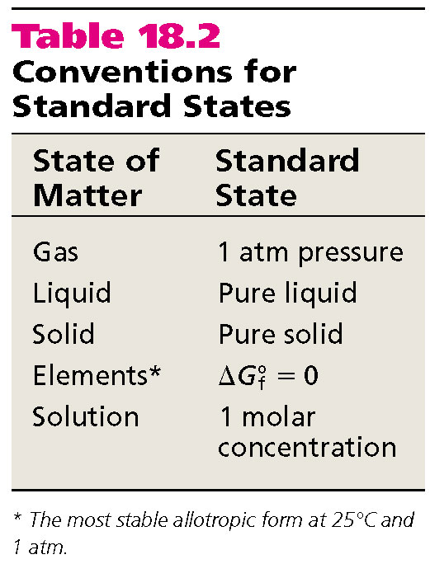
The standard free-energy of reaction (ΔG⁰ _{rxn} ) is the free-energy change for a reaction when it occurs under standard-state conditions.
aA + bB cC + dD
ΔG⁰
cΔG⁰ (C)
dΔG⁰ (D)
-
aΔG⁰ (A)
bΔG⁰ (B)
=
[
+
]
[
+
]
rxn
f
f
f
f
ΔG⁰
-
Σ
nΔG⁰ (reactants)
=
Σ
nΔG⁰ (products)
rxn
f
f
Standard free energy of formation (ΔG⁰) is the free-energy change that occurs when 1 mole of the compound is formed from its elements in their standard states.
f
ΔG⁰ of any element in its stable form is zero.
f
18.4
Notes:
‹#›

Slide 27
What is the standard free-energy change for the following reaction at 25 ⁰C?
2C₆H₆ (l) + 15O₂ (g) 12CO₂ (g) + 6H₂O (l)
ΔG⁰
=
Σ
nΔG⁰ (products)
-
Σ
mΔG⁰ (reactants)
rxn
f
f
ΔG⁰
2ΔG⁰ (C₆H₆)
12ΔG⁰ (CO₂)
6ΔG⁰ (H₂O)
-
[
]
=
[
f
+
f
]
f
rxn
ΔG⁰
=
[ 12 x –394.4 + 6 x –237.2 ] – [ 2 x 124.5 ] = -6405 kJ
rxn
Is the reaction spontaneous at 25 ⁰C?
ΔG⁰ = -6405 kJ
< 0
spontaneous
18.4
Notes:
‹#›

Slide 28
Temperature and Spontaneity of Chemical Reactions
CaCO₃ (s) CaO (s) + CO₂ (g)
ΔH⁰ = 177.8 kJ; Does not favor spontaneous reaction
ΔS⁰ = 160.5 J/K; Favors spontaneous reaction
ΔG⁰ = ΔH⁰ – TΔS⁰
Determine the temperature range where the
above reaction will be spontaneous.
0 = ΔH⁰ – TΔS⁰
-ΔG; spontaneous
ΔG=0;equilibrium
+ΔG;nonspontaneous
ΔH⁰ = TΔS⁰
T=ΔΗ⁰/ ΔS⁰
T = 177.8 kJ/ 0.1605 kJ/K =1108K
Notes:
‹#›

Slide 29
Gibbs Free Energy and Phase Transitions
Ice melting;
Liquid vaporizing
Solid subliming
H₂O (l) H₂O (g)
Phase changes happen at equilibrium
ΔG⁰ = 0
ΔG⁰ = ΔH⁰ – TΔS⁰
T=ΔH⁰/ ΔS⁰
Determine the boiling point of water given that
ΔS_{vap} = 109.3 J/mole K and ΔH_{vap} = 40.62 kJ/mole.
T = 40.6 kJ/mole = 373 K = 100 °C
0.1093 kJ/mole K
18.4
Notes:
‹#›

Slide 30
Gibbs Free Energy and Chemical Equilibrium
-ΔG; spontaneous
ΔG=0;equilibrium
+ΔG;nonspontaneous
Q<K; forward rxn spontaneous
Q=K ;equilibrium
Q>K;forward rxn nonspontaneous
ΔG = ΔG⁰ + RT lnQ(K)
R is the gas constant (8.314 J/K•mol)
T is the absolute temperature (K)
(K)Q is the reaction quotient = (products/reactants)
ΔGº is change in Gibbs Free Energy
under standard state conditions
ΔG is change in Gibbs Free Energy
under experimental conditions
Notes:
‹#›

